Slide 1
Michael and Sally McCracken
Student Research Symposium
Senior Capstone Project 2016-2017
Computer Science Department
College of Science and Engineering
Texas Christian University
Notes:
Changed
Added page numbers to all slides

Slide 2
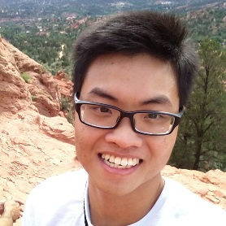
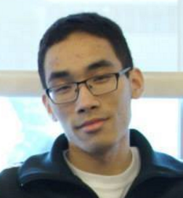
Meet the Team
James Stewart
Project Lead
Quang Nguyen
Thaddeus Rix
Son Nguyen
Michael Giba
Technical Lead
Notes:
Animate to move them to the front when people introduce themselves

Slide 3
Outline
What is SRS?
Project Background and Goals
Features and Enhancements
Technology Overview
Challenges
Future Work
Acknowledgements
Q & A

Slide 4
What is SRS?
TCU CSE Student Research Symposium
Students submit research projects
Graduate
Undergraduate
Judged by departments
Annual spring forum for presentations
Visitors
Presenters
Admins

Slide 5
Who’s Involved in SRS
Students
Authors
Presenters
Faculty
Advisors
Judges
Viewers
Family & friends
Public
Administrators
Organizers
Chairs

Slide 6
Old System Problems
Unsatisfactory user interface
Not mobile friendly

Slide 7
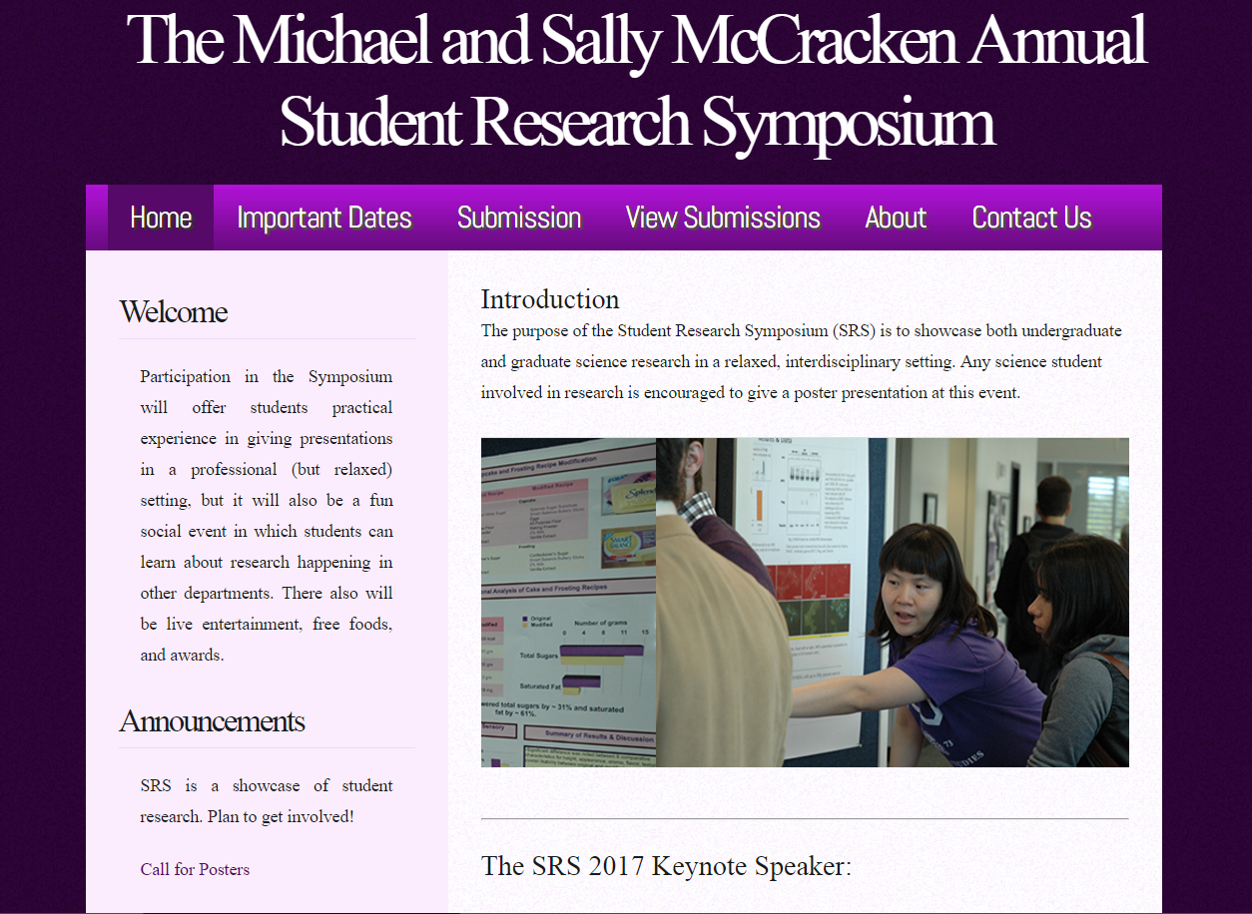
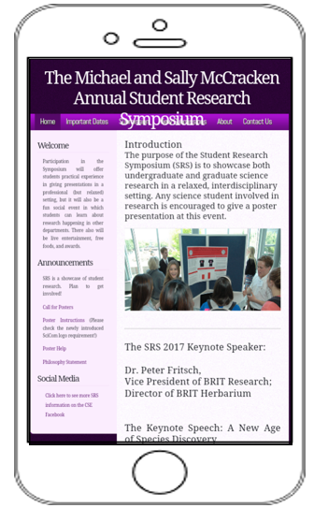
Old System Problems

Slide 8
Old System Problems
Unsatisfactory user interface
Not mobile friendly
Deficient database design
Insufficient report functionality
Inadequate administrative controls

Slide 9
Project Goals
Redesigning and restructuring the SRS site
Applying modern GUI design
Designing with UX/UI in mind
Engineering a device-agnostic site
Building a new submission/review system with new tools and features
Architecting a relational database
Creating an admin panel
Enhancing report functionality

Slide 10
Submission Problems
Single submission by author
Limitations on number of authors and advisors
Updates only by admins
Duplicates in database
Potential security threats

Slide 11
Submission Enhancements
Registration process
Poster submission
Information management
Password recovery
Submission
Portal
Notes:
Poster centric
Shared among authors/advisors
Allow authors and advisors to participate in multiple posters
Avoid unnecessary registration of student accounts

Slide 12
Registration Process
Registration
Abstract
Submission Portal
Information management
Primary Author
Primary Advisor
Credentials Emailed
Poster Submission

Slide 13
Adding Additional Authors
Notes:
Add/Remove/Update information of:
Author(s)
Advisor(s)
Guest(s)

Slide 14
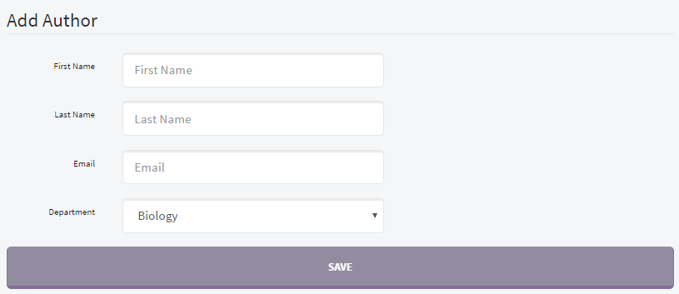
Adding Additional Authors
Notes:
Add/Remove/Update information of:
Author(s)
Advisor(s)
Guest(s)

Slide 15
Adding Guests
Notes:
Add/Remove/Update information of:
Author(s)
Advisor(s)
Guest(s)

Slide 16
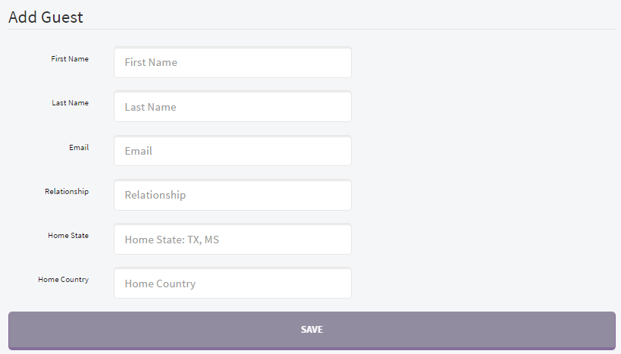
Adding Guests
Notes:
Add/Remove/Update information of:
Author(s)
Advisor(s)
Guest(s)

Slide 17
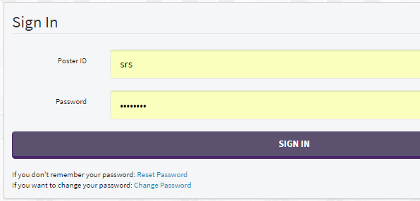
Password Management
Notes:
Replace with red circles

Slide 18
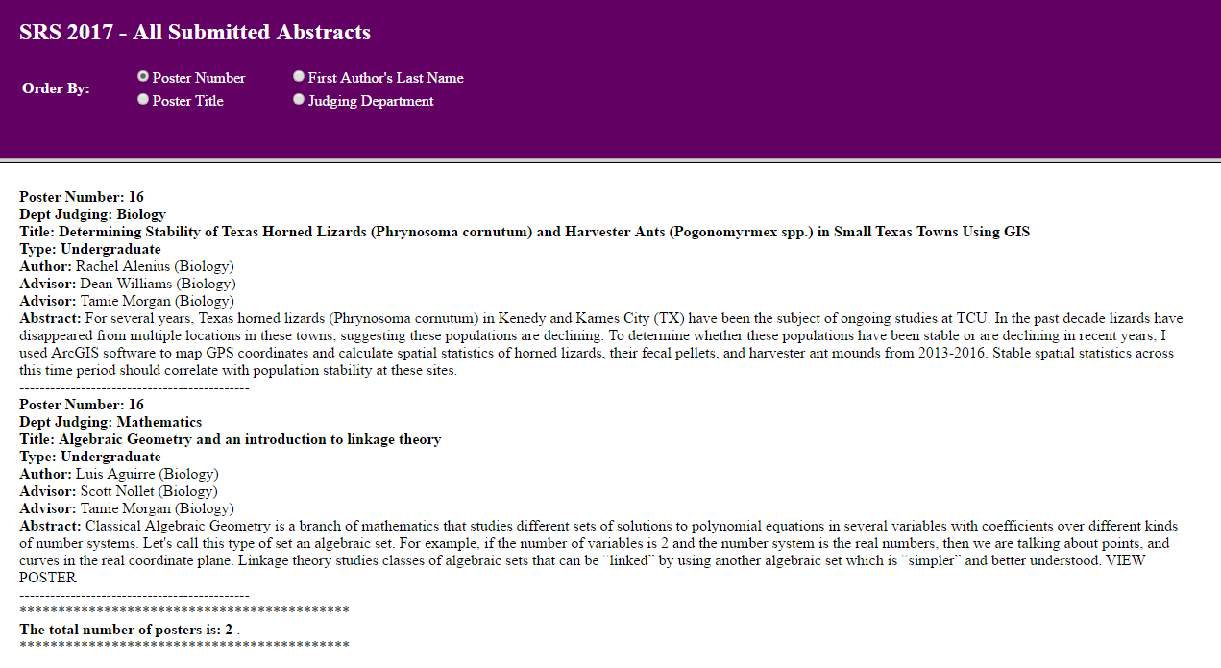
Viewer Problems
Notes:
Should show how bad the old site was

Slide 19
Viewer Enhancements
Acquiring Statistics
Searching Posters
Filtering Posters
Clear Presentation
Private Posters

Slide 20
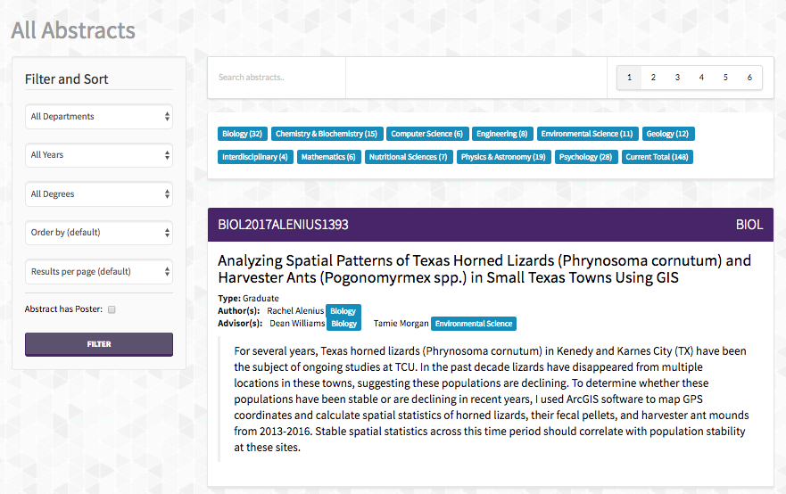
Viewer

Slide 21
Search Bar

Slide 22
Filter and Order By

Slide 23
Poster Display

Slide 24
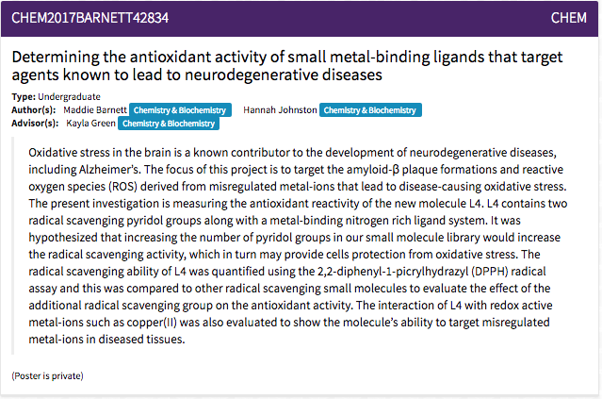
Private vs. Public Posters

Slide 25
Reviewer Problems
Manual ballot creation
Every reviewer needed authentication
No history of past winners

Slide 26
Reviewer Enhancements
Automatic ballot creation
Authentication with special links
Record winners in database

Slide 27
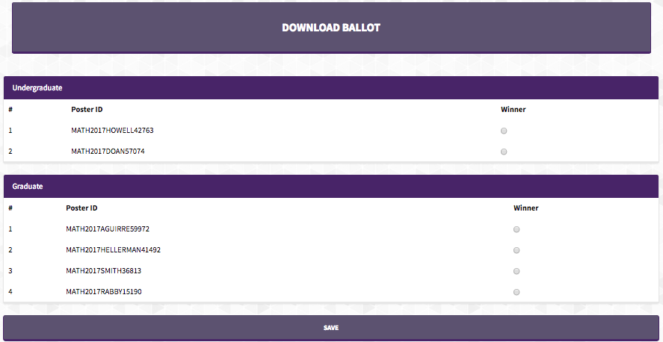
Reviewer Portal

Slide 28
Reviewer Portal

Slide 29
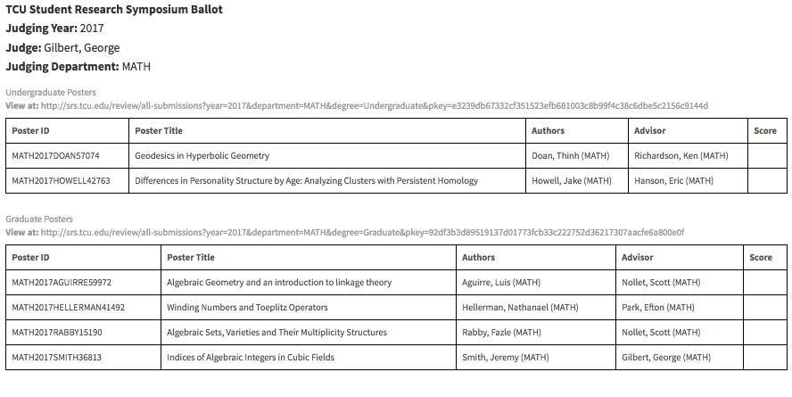
Reviewer Ballot

Slide 30
Reviewer Ballot

Slide 31
Winner Selection

Slide 32
Admin
Updating Site Information
Automating Table Assignment Task
Reporting

Slide 33
Updating Site Information
Annual Speakers
Announcements
Events
Notes:
Say numerous others

Slide 34
Table Assignments

Slide 35
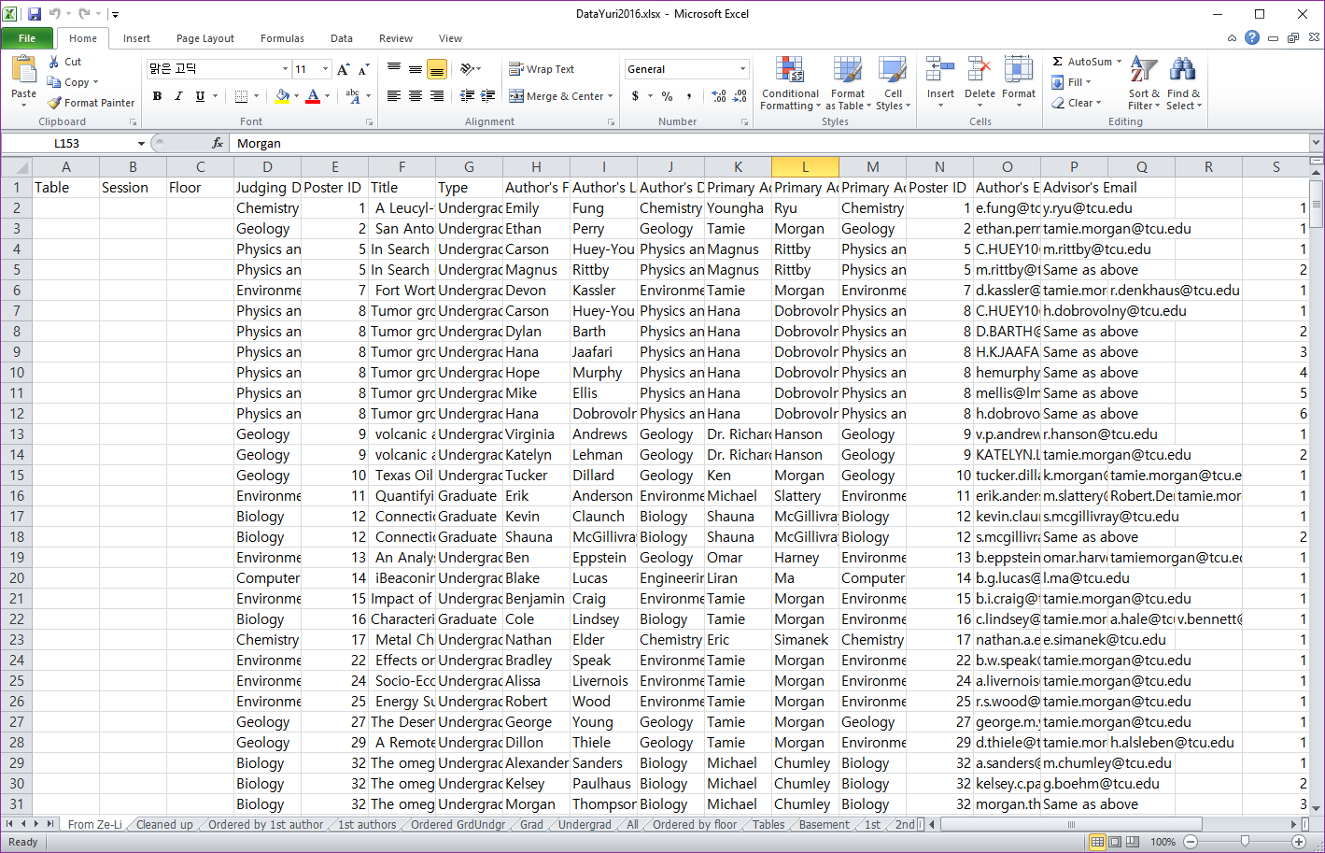
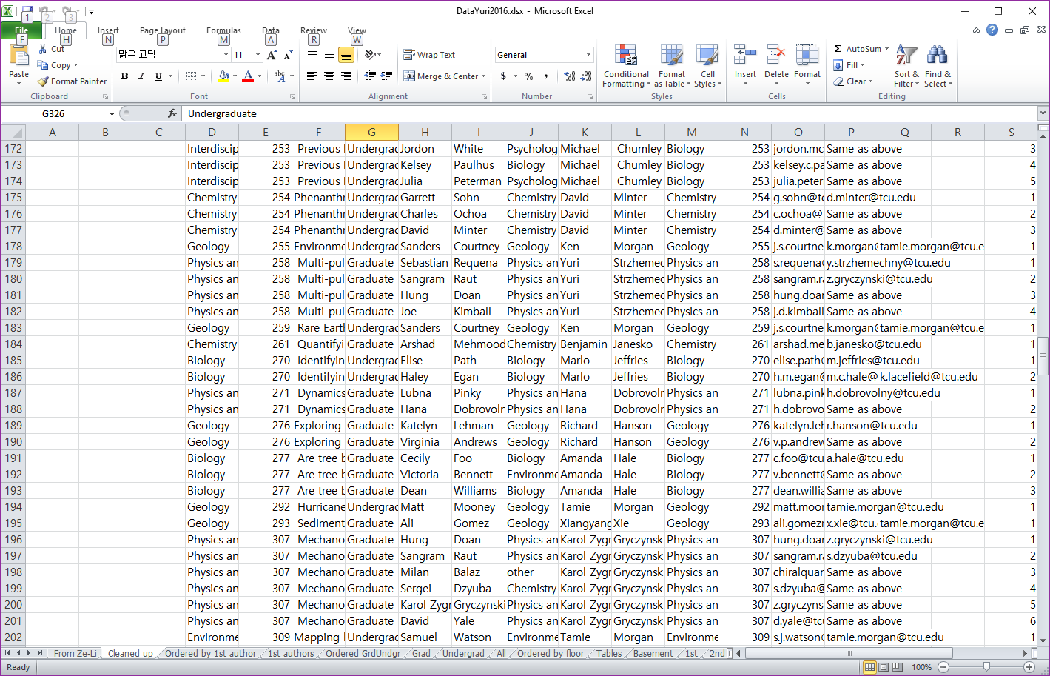
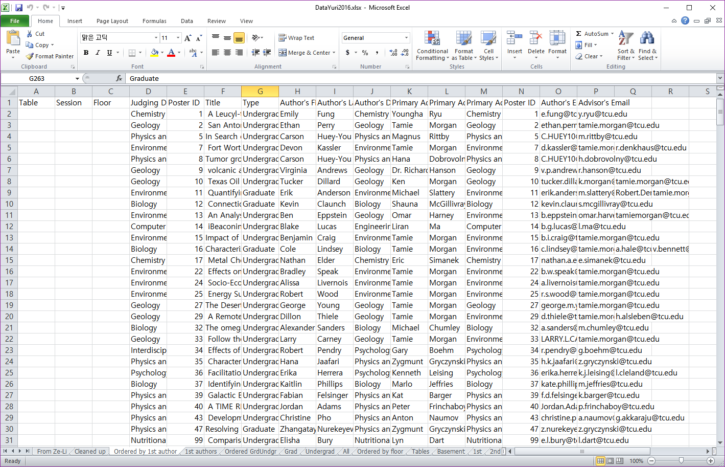
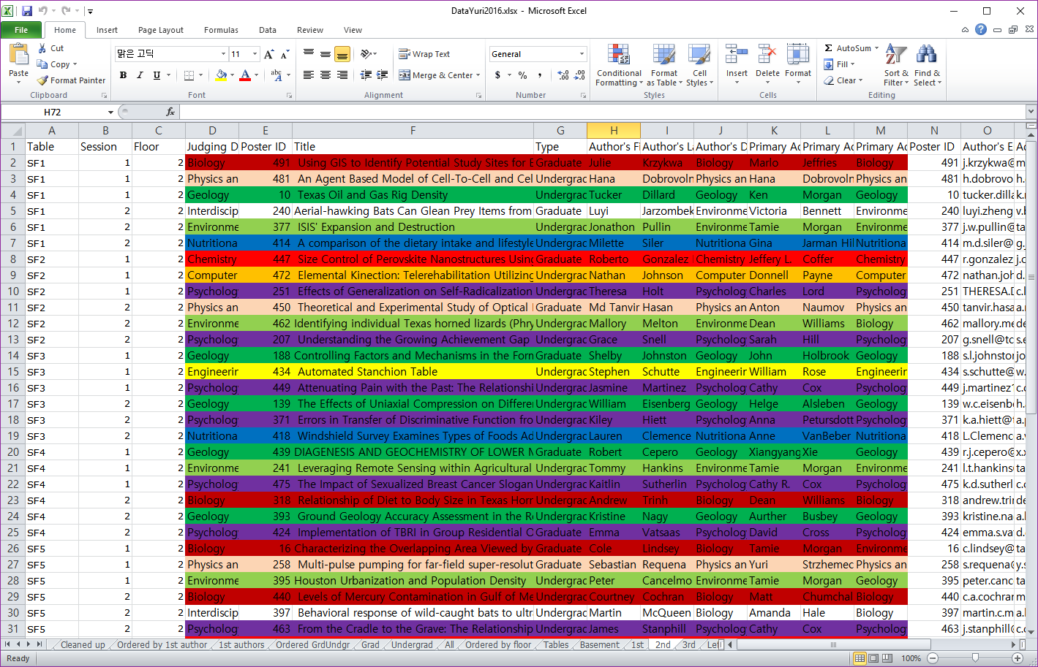
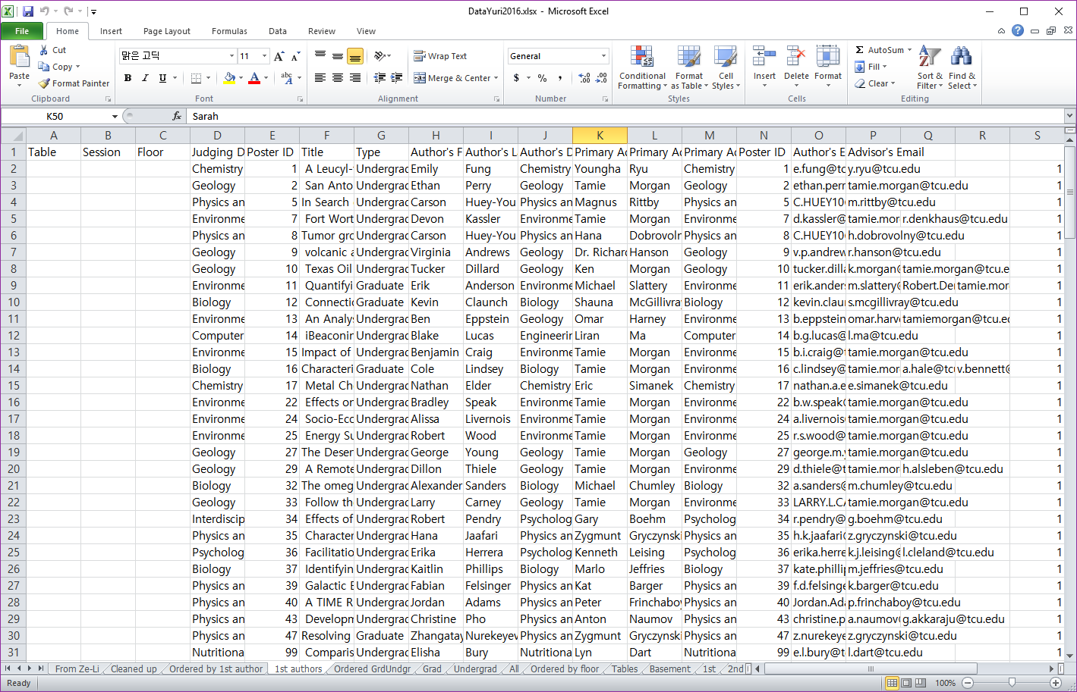
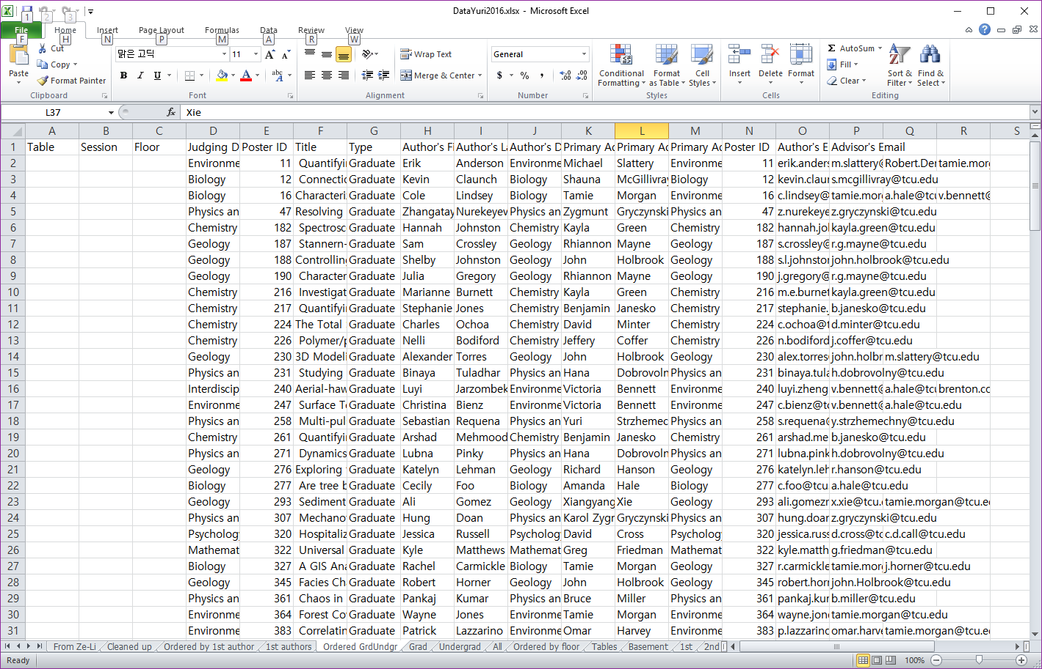
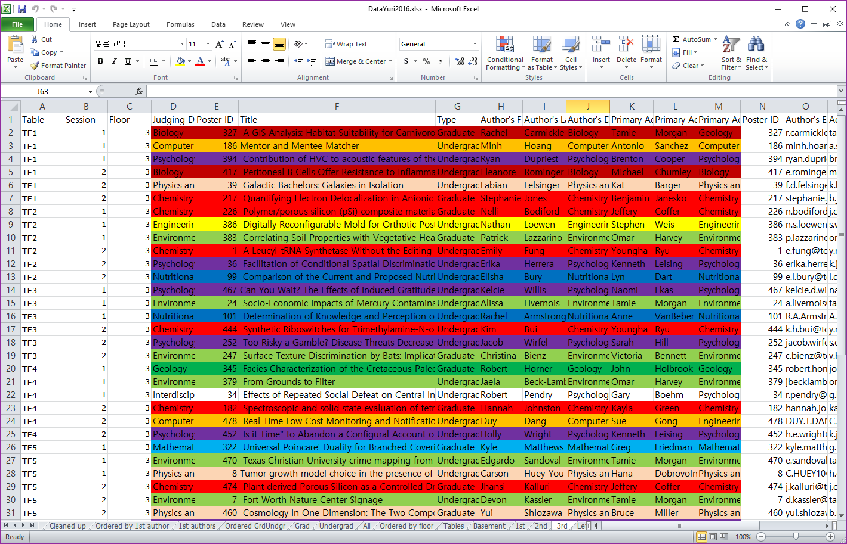
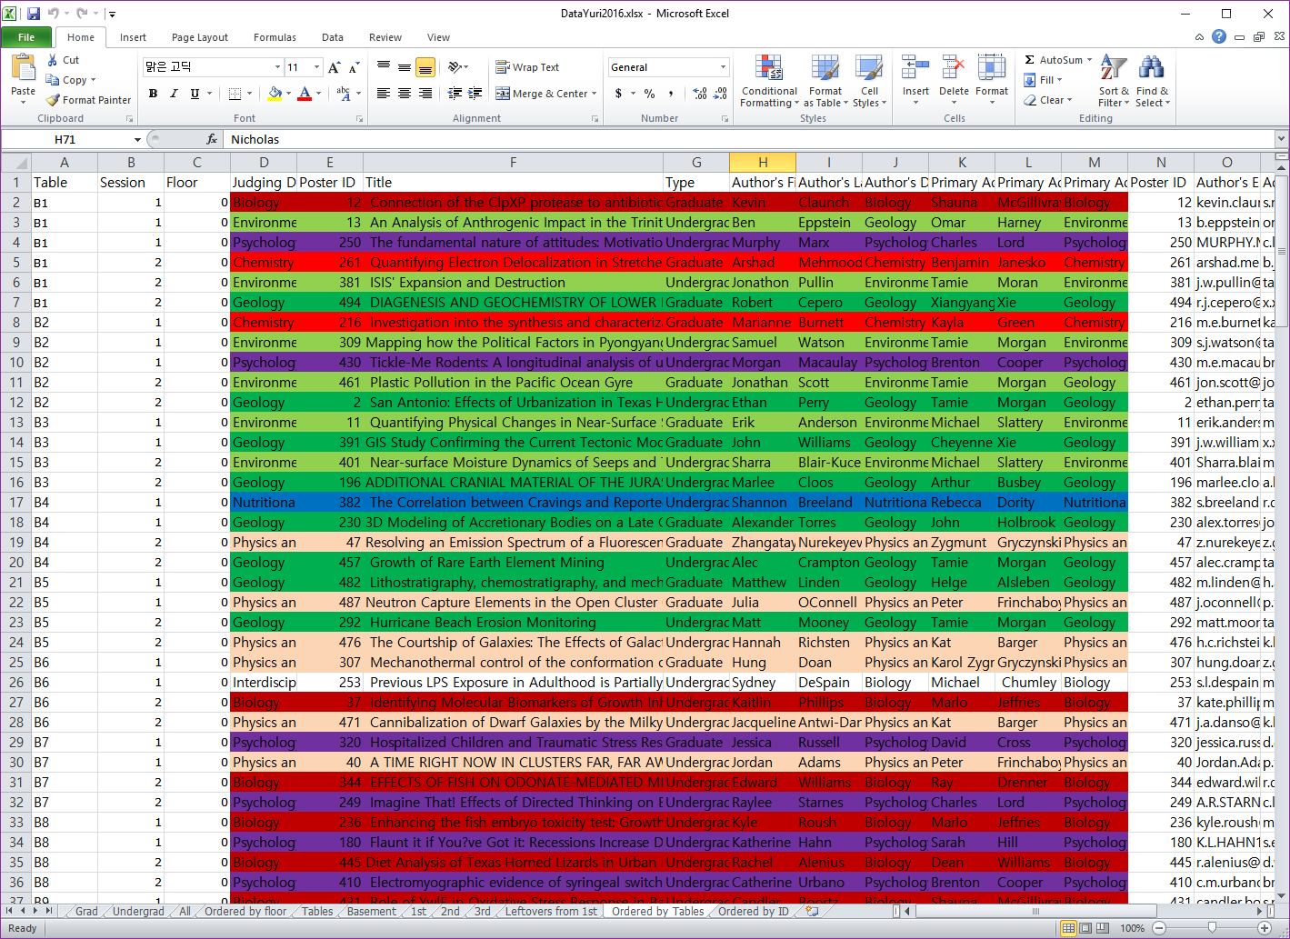
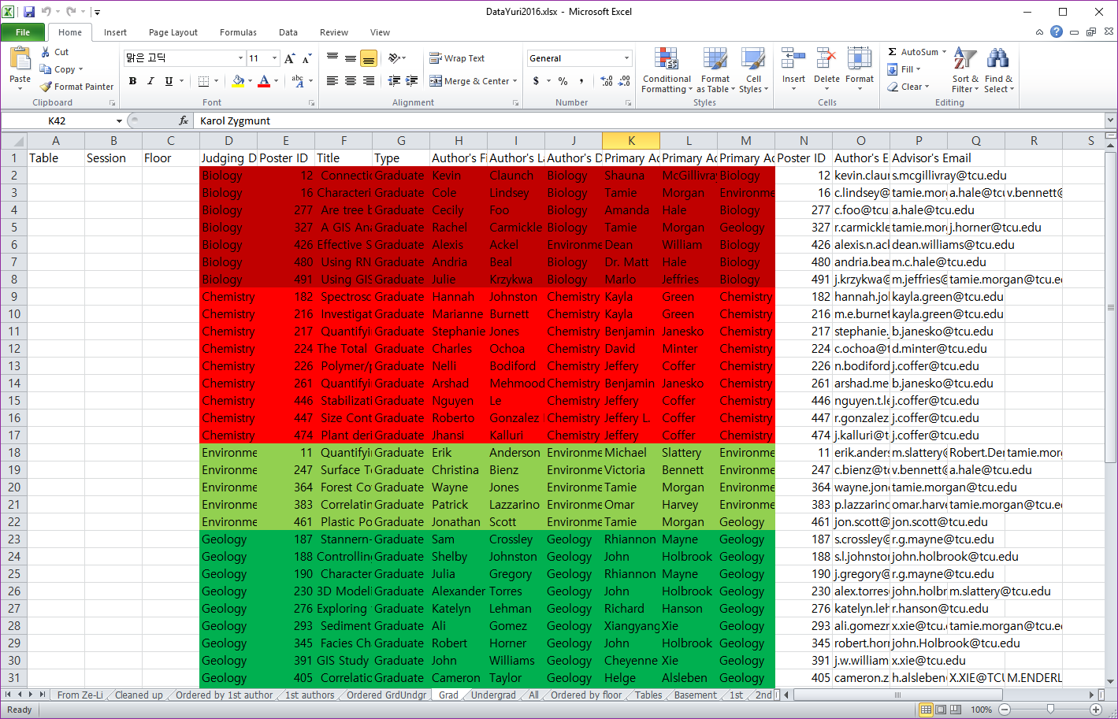
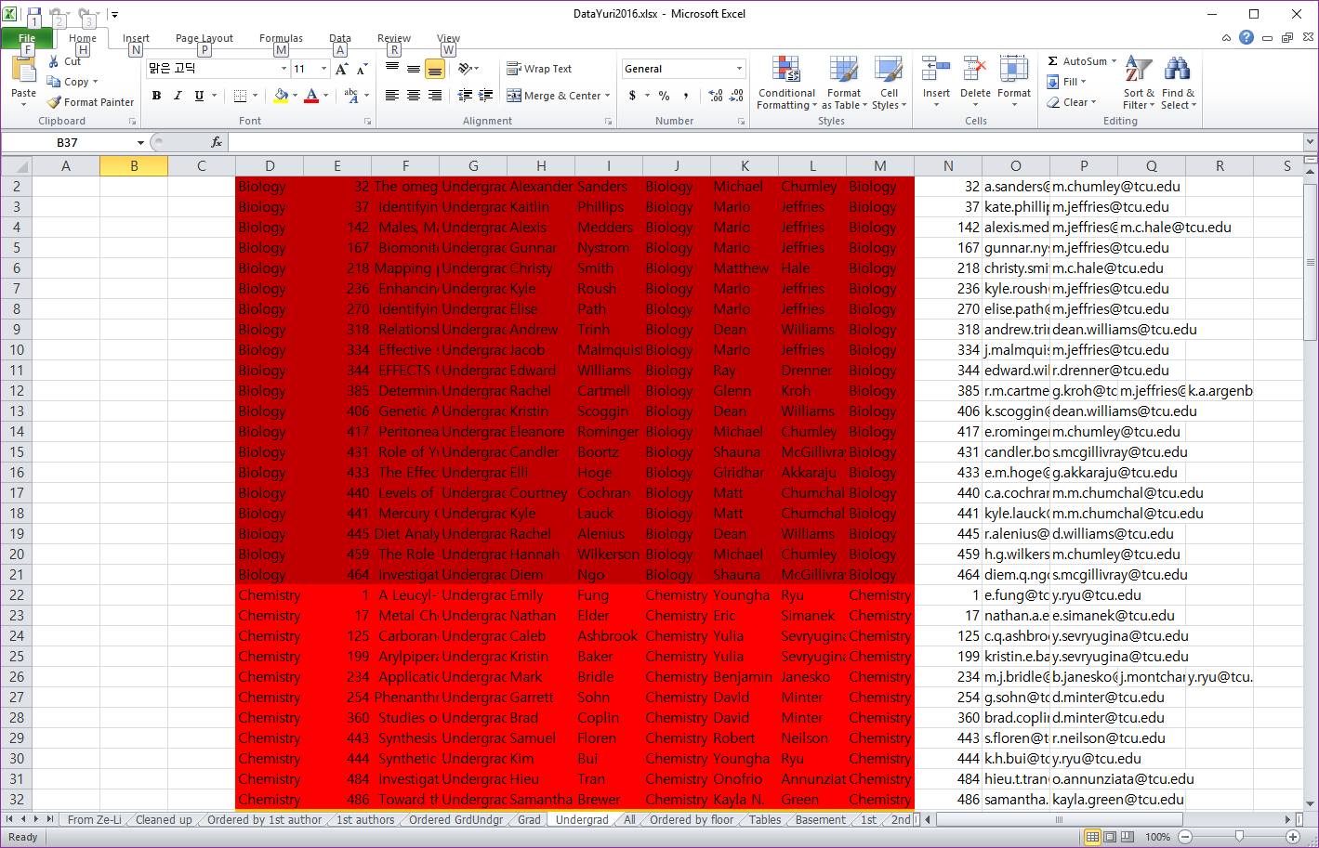
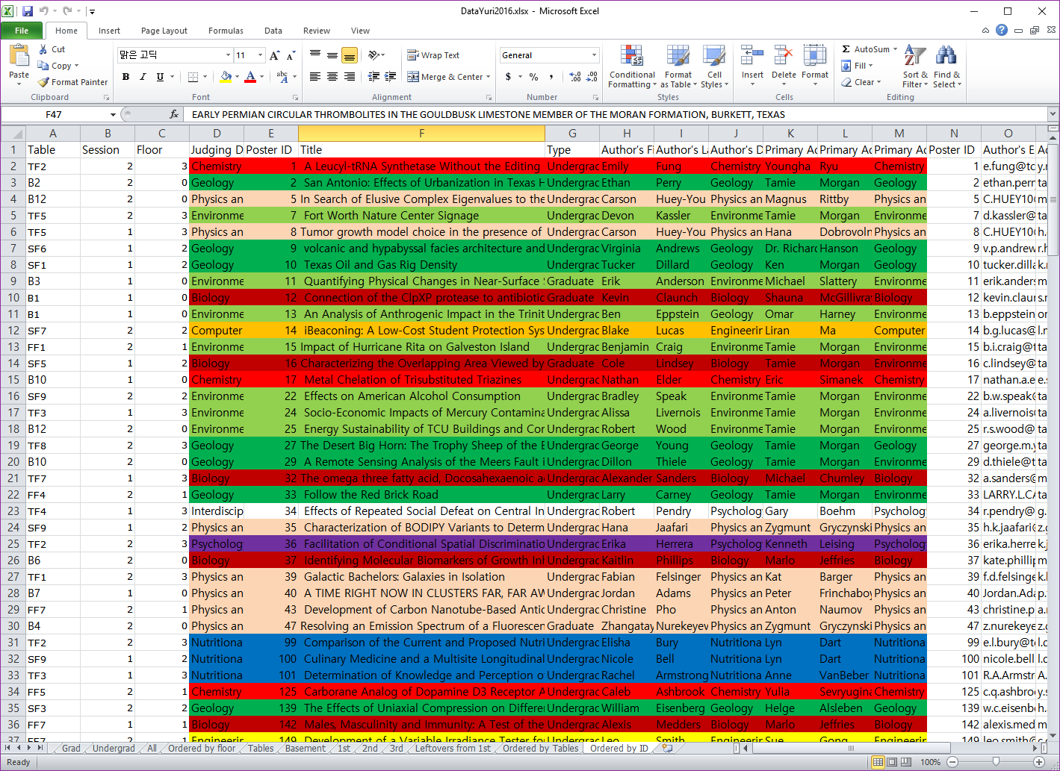
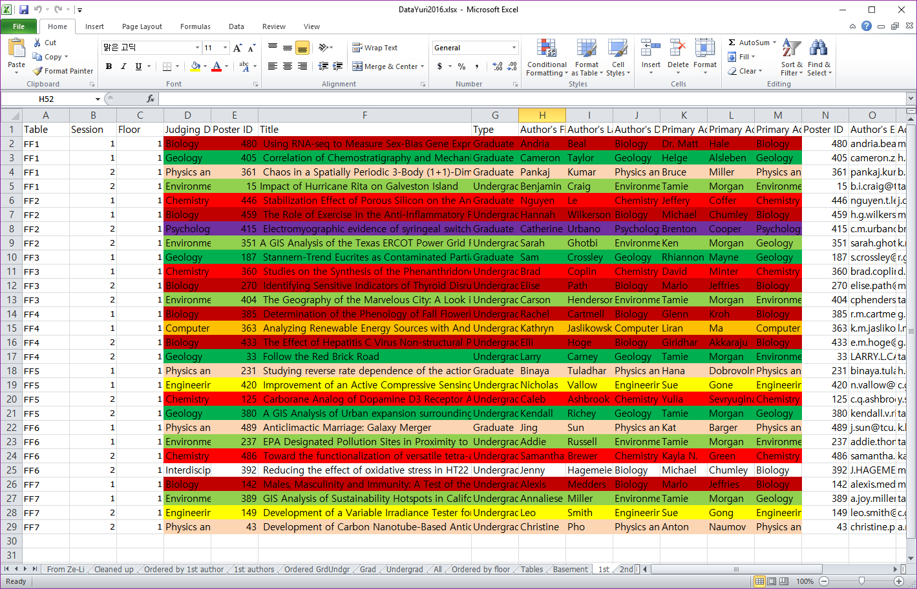
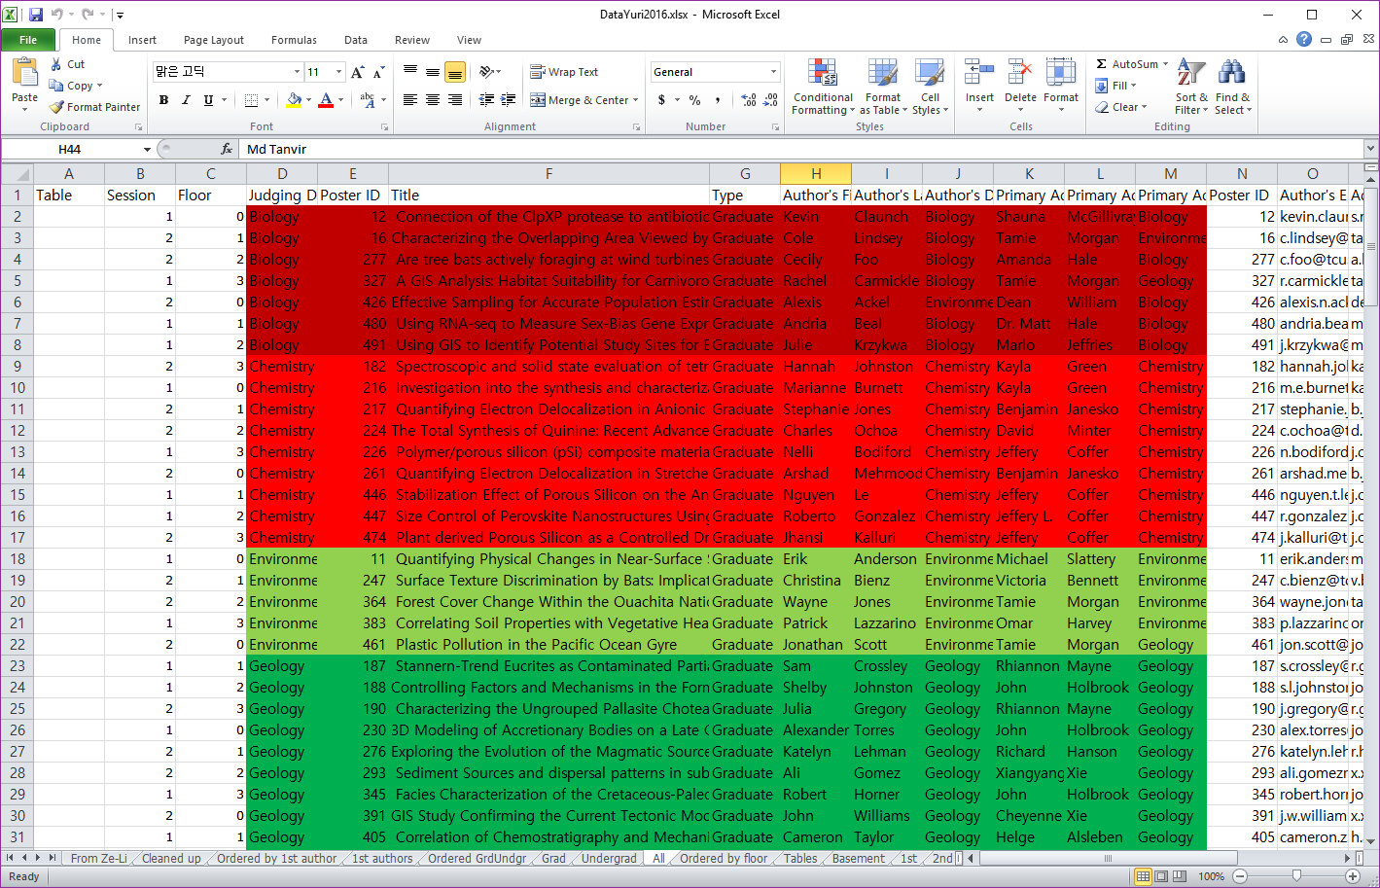
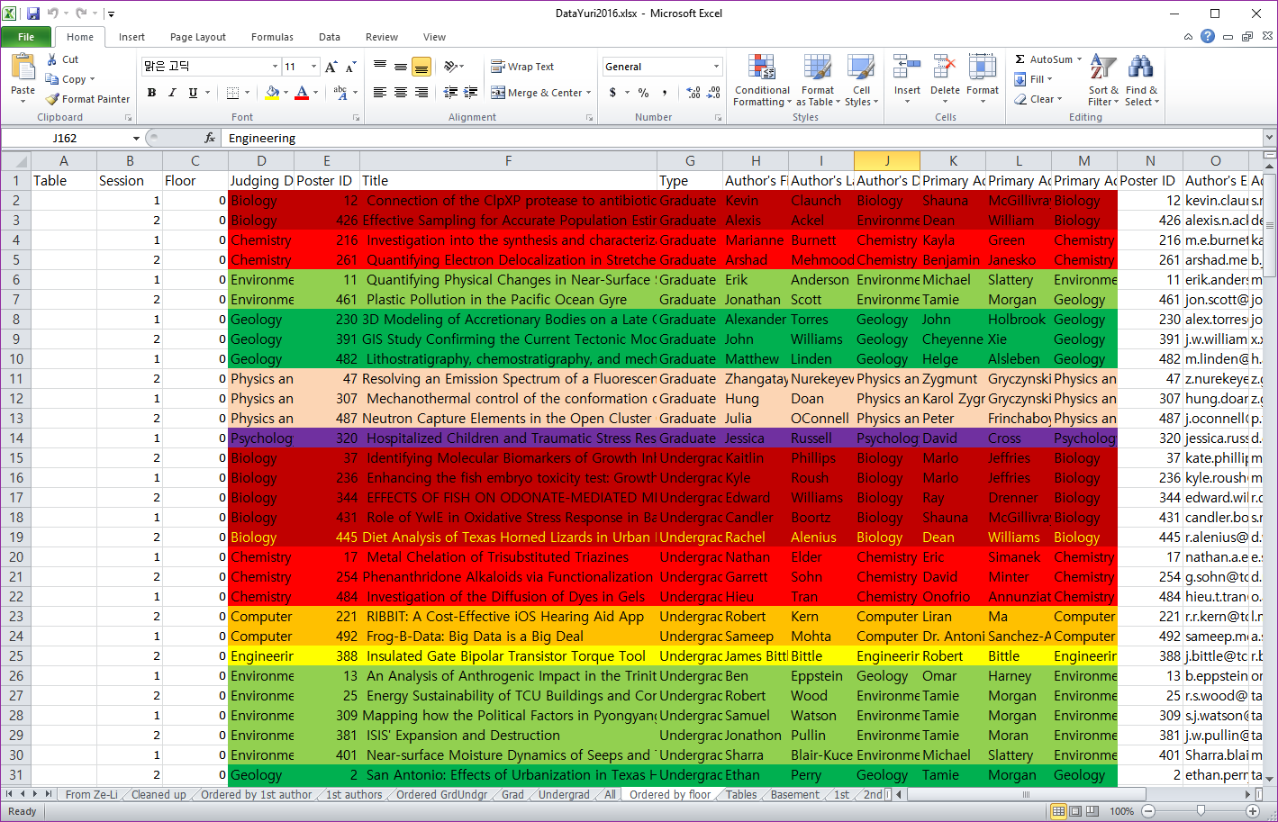
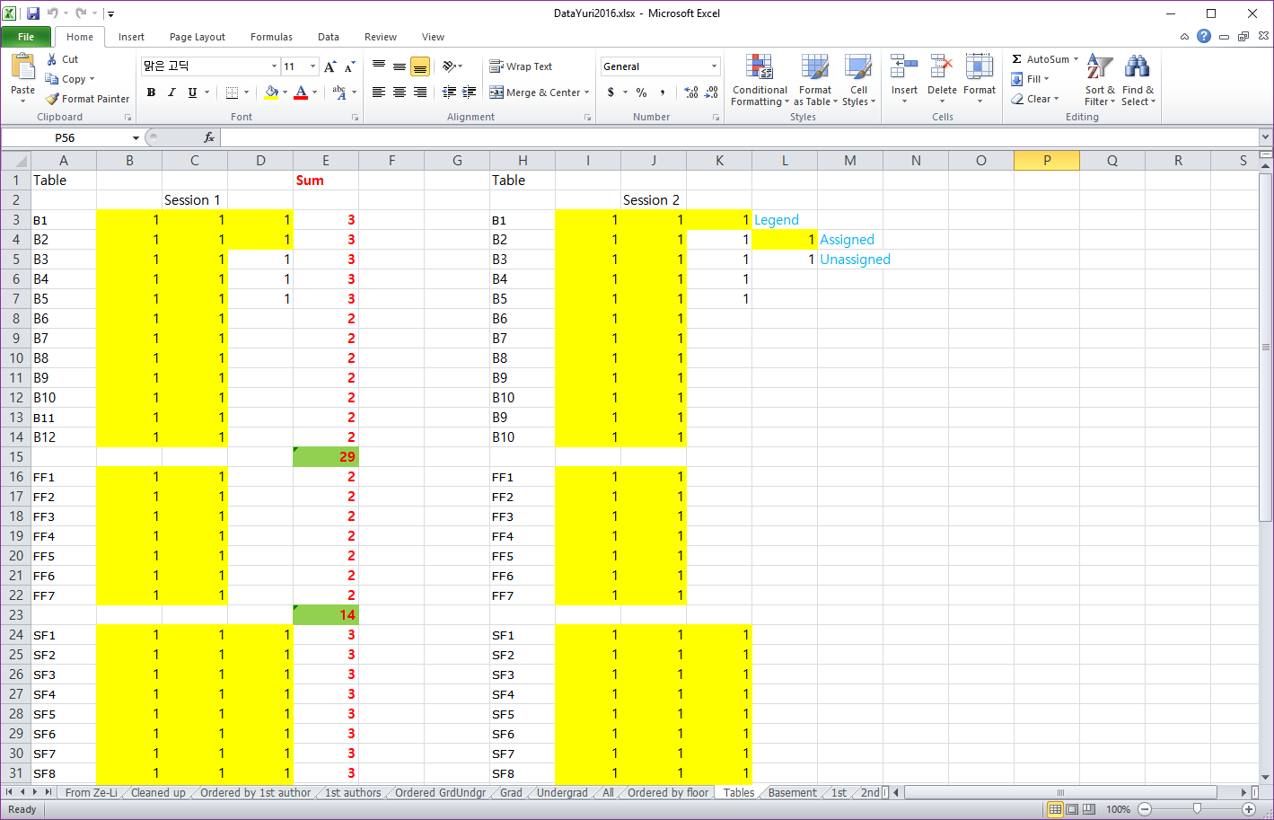
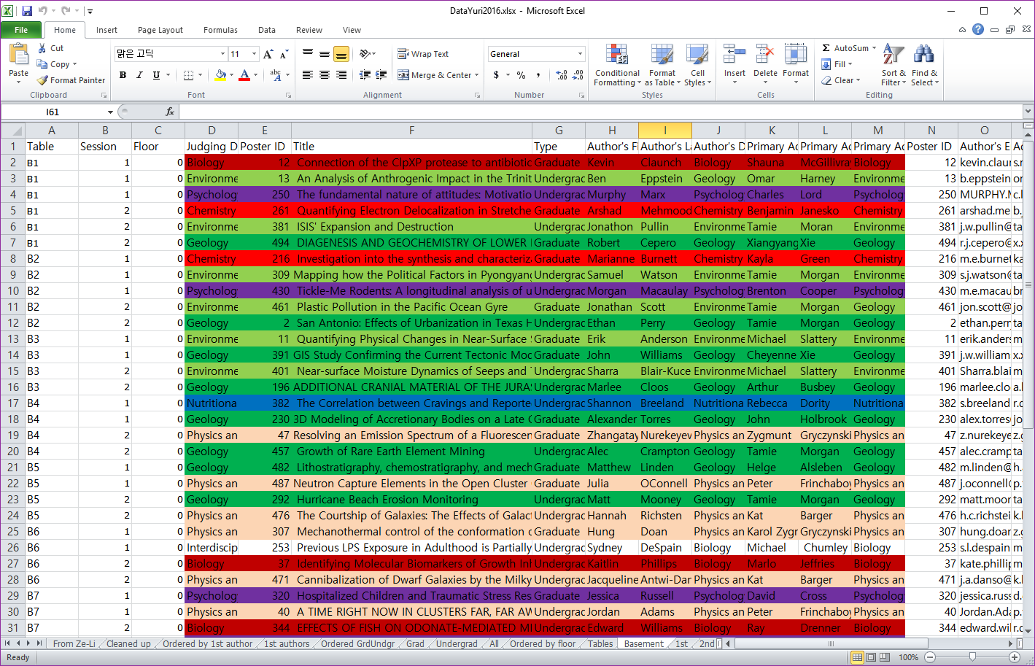
Table Assignment (before)
Linear Process
Time-consuming
Waste of Human Resources
Human Errors

Slide 36
Table Assignment Algorithm
Criteria
Handle Special Requests from students
Prevent tables from having two posters from the same department
Algorithm
Determine the number of seats needed
Select the highest priority seats according to that number (e.g, avoid tight hallways)
Assign posters to the highest priority seats while matching the above criteria

Slide 37
Table Assignment Algorithm

Slide 38
Reporting
Author Report
Guest Report
Table Assignment Report
Author Name Badges
Guest Name Badges
Notes:
Say there are numerous others not listed

Slide 39
Reporting

Slide 40
Technologies Used
Django
Bootstrap
Semantic UI
Apache
PostgreSQL

Slide 41
Technologies Used: Django
Overview
Parametrized URLs
Templating
Seamless database connection
Migrations
Admin panel
Avidly maintained
Open source

Slide 42
Technologies Used: Bootstrap
Overview
Cross browser support
Open source
Themes
Grid System
Responsive
Control object sizing
Mobile optimized

Slide 43
Technologies Used: SemanticUI
Overview
Less important
Small UI elements
Badges
Pagination

Slide 44
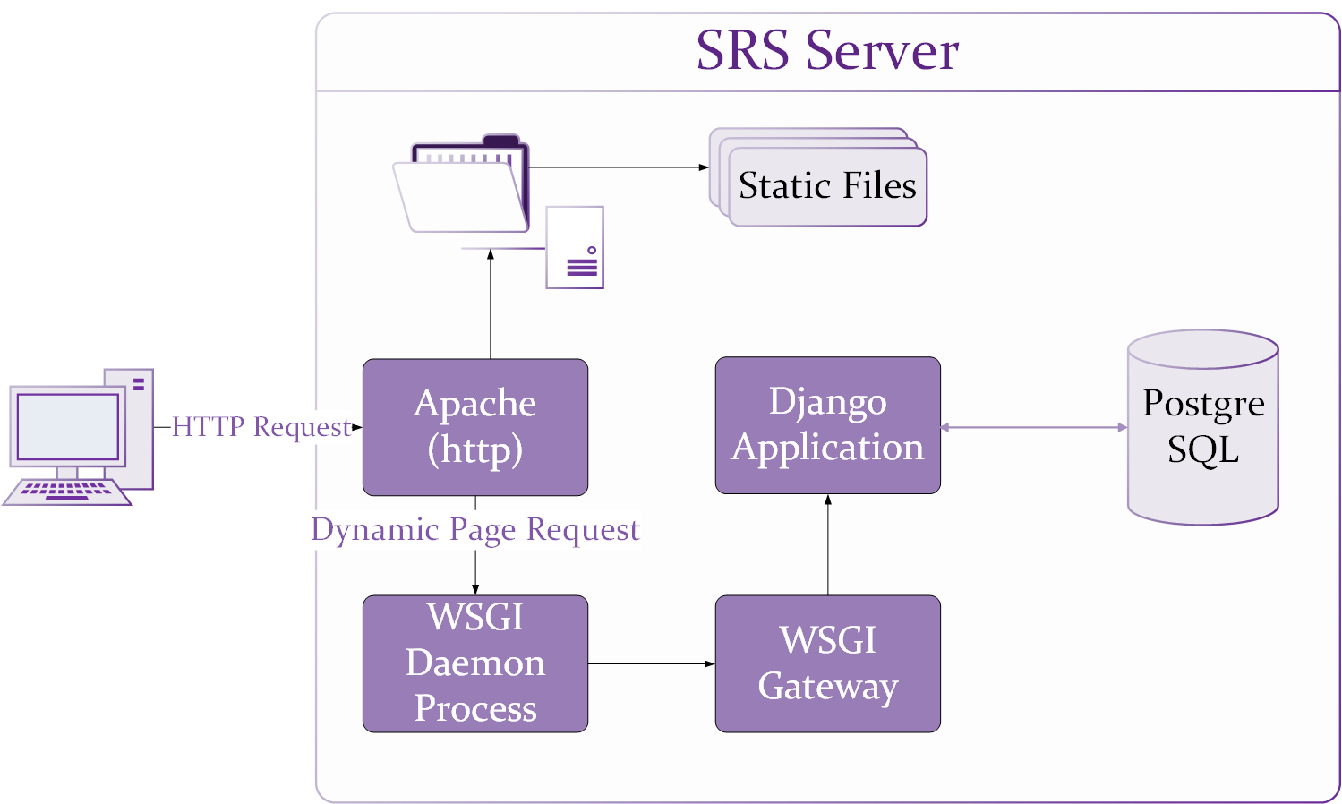
Technologies Used: Apache

Slide 45
Challenges
Table assignment algorithm
Many SRS event changes
Growing client-base
Overspecialization of roles

Slide 46
Lessons Learned
How to interface with lots of clients
Deadlines are faster than you think
Working face-to-face is far more efficient than working remotely
Peer-review EVERYTHING
Anticipate “callow” users

Slide 47
Future Work
Ongoing support
Registration improvements
Poster management enhancements
Email reminders
Port of system for other competitions

Slide 48
Acknowledgements:
Dr. Donnell Payne
Mr. Billy Farmer
Dr. Liran Ma
Notes:
Include a picture of Michael McCracken

Slide 49
Questions?

